Slide 1

GS-SLAM: Dense Visual SLAM with 3D Gaussian Splatting
STAGE 1: Voxel-Based SLAM (Foundation) Scene Representation
Frame 1: The camera estimates a TSDF value of (0.8) for a voxel.
Frame 2: The camera moves slightly and estimates (0.6) for the same voxel.
Frame 3: Another observation estimates (0.7).
The measurements differ slightly because of sensor noise, camera movement, and measurement uncertainty.
TSDF fusion combines them rather than replacing the old value each time.
The formula

Slide 2
This is how the pieces of Voxel SLAM reconstruction pipeline:
The depth camera captures a new frame.
ICP estimates the camera pose relative to the existing map or previous frame.
The system uses that pose to transform the new depth measurements into the map's coordinate system.
TSDF fusion combines those measurements with existing voxel values.
Marching Cubes extracts a surface mesh from the fused TSDF volume.

Slide 3

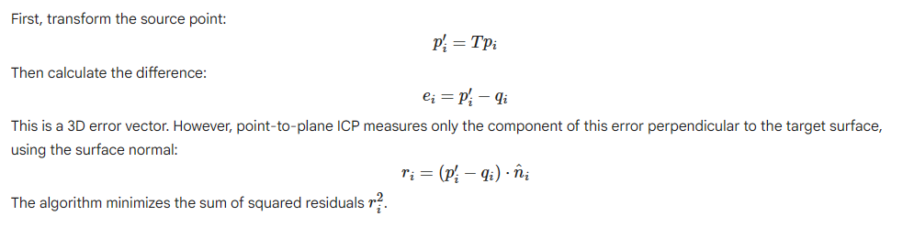
ICP (Iterative Closest Point) is an algorithm that helps a robot estimate how its camera moved between two frames by aligning 3D points from the two frames.
Frame 1: the camera sees a set of 3D points on the wall.
Frame 2: the camera moves slightly and sees the same wall from a different position. The two point clouds won't line up automatically because the camera moved.

Slide 4







First-order approximation of a rigid transformation near the identity.
When the current estimate is not the identity, this approximation is applied to a small incremental transformation and composed with the current estimate.
Define the six unknowns. Combine rotation and translation into a six-dimensional vector
cross-product identity

Slide 5
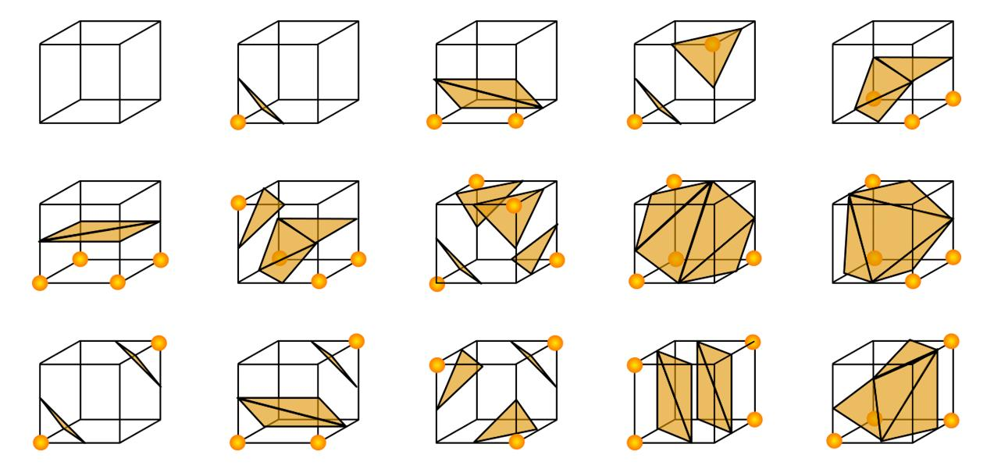

Marching Cubes converts the TSDF volume into a 3D surface mesh that a robot can visualize or use for planning.
Marching Cubes processes the 3D voxel grid one cube at a time.
Take one cube: Each cube has eight corner voxels.
Check their TSDF values: Determine which corners are negative and which are positive.
Find zero-crossings: Interpolate along cube edges whose endpoints have opposite signs.
Create triangles: Connect the crossing points to approximate the surface inside that cube.
Repeat: Process the entire volume and join the resulting triangles into a mesh. The result is a triangular surface mesh rather than just a collection of voxel values.

Slide 6


iMAP — replacing voxels with a neural network
iMAP neural map The scene is encoded in the learned parameters of a neural network. Querying the network at a 3D position estimates properties of the scene there.
The neural network is written as
σ : volume density,
C – Pixel colors

Slide 7
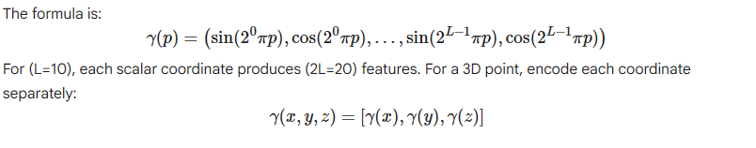
Positional encoding helps by giving it sinusoidal features at multiple spatial frequencies.

Slide 8

Volume rendering:
The network predicts color and density at a 3D point, but a camera pixel represents everything visible along a ray through the scene.
To predict one pixel, we cast a ray:
where:
o : camera origin.
d : ray direction through the pixel.
t : distance parameter along the ray.

Slide 9
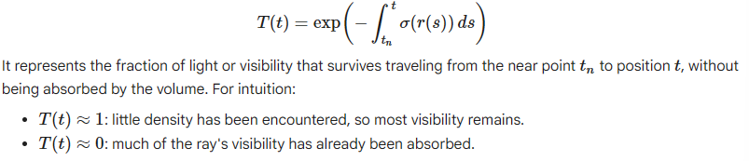
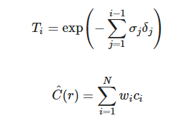



Slide 10
The complete iMAP pipeline
Capture RGB-D frame Obtain color and depth measurements
Sample camera rays Generate 3D sample positions along selected pixel rays
Query the MLP Predict color and density at sampled positions
Render color and depth Combine predictions using volume-rendering weights
Compute loss Compare rendered results with observed RGB-D data
Update scene and camera pose Optimize neural parameters and pose, then process the next frame

Slide 11
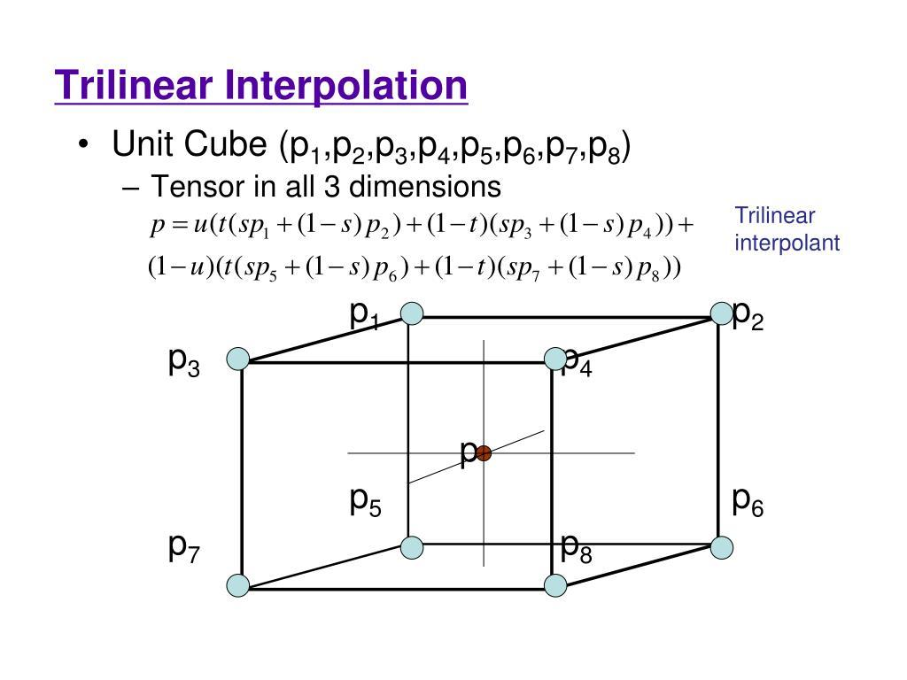

Slide 12
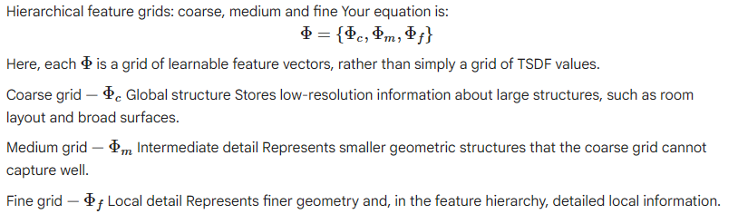
NICE-SLAM: Stores learned features in multi-resolution grids, with neural decoders that turn those features into scene properties.

Slide 13

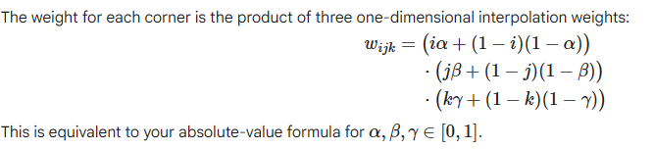


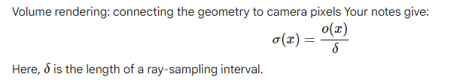
The feature at the sample position is interpolated from the eight corners:
After interpolation, each grid gives a feature vector at the queried position:
These are combined and passed to a small decoder network:

Slide 14
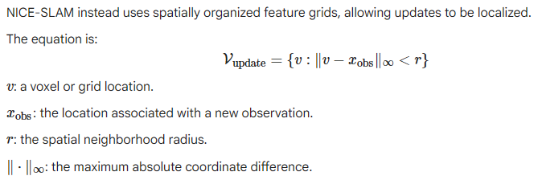

Slide 15

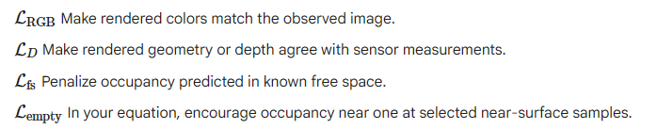

Slide 16
Why is NICE-SLAM still slow?
NICE-SLAM improves the scene representation, but it still has to perform substantial computation.
Three grid lookups Each queried 3D position may require interpolation at coarse, medium, and fine resolutions.
Ray marching A pixel still requires sampling multiple positions along its camera ray. If there are 32 samples, the scene must be queried at those 32 locations.
Neural decoding and optimization Feature interpolation, decoder evaluations, rendering, and gradient updates all consume computation.

Slide 17
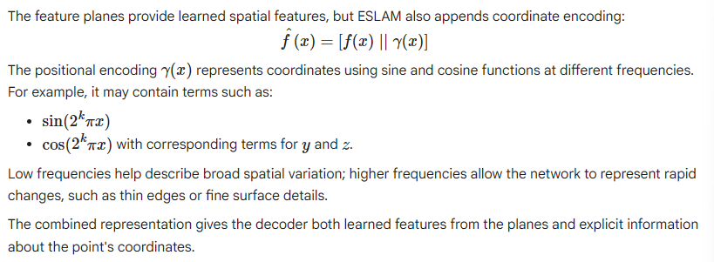
ESLAM: stores learnable features in multi-scale 2D planes and combines them to represent 3D geometry.
Now imagine three 2D planes, each containing n x n locations:

Slide 18
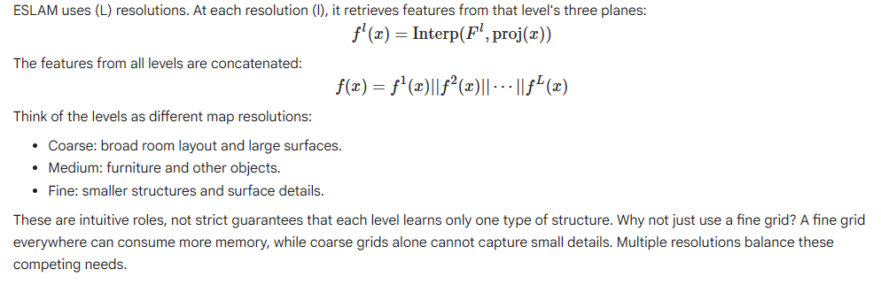

Slide 19
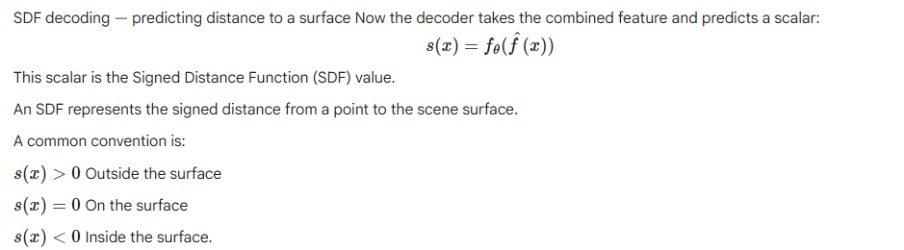

Slide 20
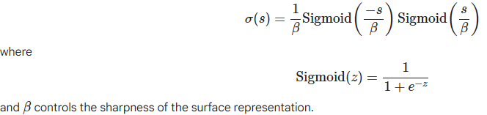
But E Slam needs SDF to density :
Neural rendering needs a density value along each camera ray.
ESLAM can convert the SDF into density using the formula:

Slide 21
Complete Algorithm of E SLAM
3D query point
Project onto XY, XZ and YZ feature planes
Bilinear interpolation at multiple scales
Concatenate features and positional encoding
Neural decoder predicts SDF
Convert SDF to density and render camera rays

Slide 22
3D Gaussian Splatting (3DGS) — from neural fields to fast rendering
The big conceptual change is this: iMAP, NICE-SLAM and ESLAM query a scene representation at many points along camera rays.
3D Gaussian Splatting instead represents the scene as a collection of explicit, learnable 3D blobs and projects those blobs onto the image.
That changes how rendering works and makes highly efficient GPU rendering possible.

Slide 23
The two rendering pipelines Neural field: ray marching Camera → many rays → many 3D sample points → query representation → combine samples
3DGS: splatting Stored 3D Gaussians → project to 2D → sort by depth → rasterize and blend

Slide 24
Each Gaussian k is represented by:
Gk={μk,Σk,ok,ck}
Center — μk μk=(x,y,z) specifies where the Gaussian is located in the world.
Shape and orientation — Σk The covariance matrix controls how wide, narrow, and rotated the ellipsoid is.
Opacity — ok Controls how strongly the Gaussian contributes to the image. In your formulation, it lies between 0 and 1.
Color — ck The Gaussian has learned color parameters, often spherical-harmonic coefficients that let its apparent color vary with viewing direction.

Slide 25
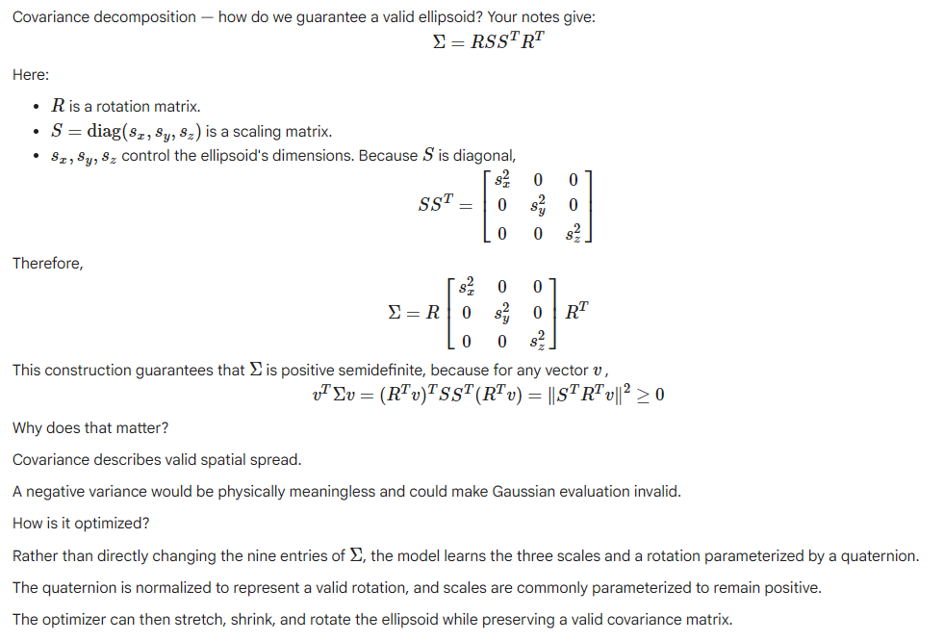

Slide 26
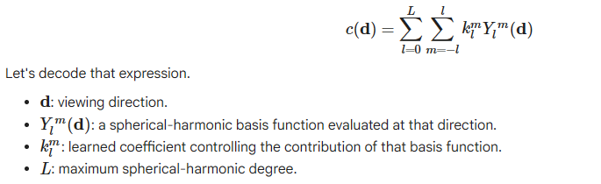
spherical harmonics as a collection of smooth patterns defined over directions in 3D.
A constant color can be represented by the lowest-order term.
Higher orders let the model represent more complicated directional changes, such as the appearance of highlights.
For example, a shiny object may look brighter from one angle than another.
View-dependent color gives 3DGS some ability to reproduce that effect without storing a completely separate color for every possible camera direction.
This is an approximation of appearance, not a complete physical simulation of light.

Slide 27

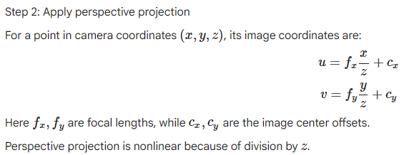
Projecting a 3D Gaussian into 2D
Step 1: Transform the Gaussian into camera coordinates.

Slide 28



Step 3: Transform the covariance The projected covariance is:
W denote the camera's linear world-to-camera rotation component.

Slide 29
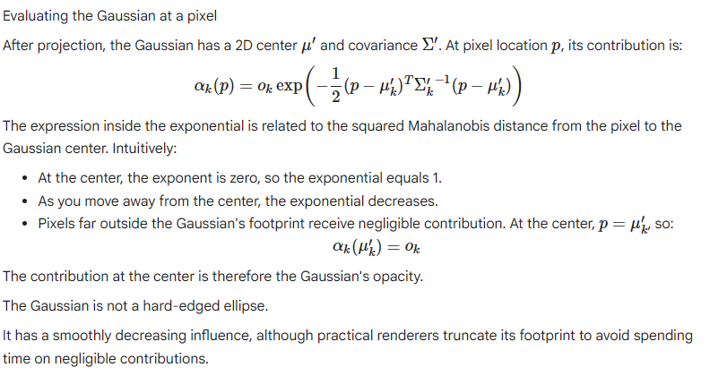

Slide 30

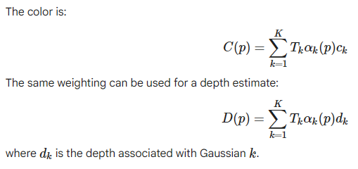
Alpha blending — combining Gaussians into a pixel
A pixel may be covered by several Gaussians.
Their colors must be combined in depth order, from front to back.
The transmittance before Gaussian k as:

Slide 31
Tile-based rasterization — why divide the screen into tiles?
Rendering every Gaussian against every pixel would be wasteful.
Most Gaussians affect only a small part of the image.
3DGS therefore divides the screen into small tiles, commonly 16×16 pixels in the implementation.
The process is:
Project each Gaussian and estimate its 2D footprint.
Compute a bounding box around the footprint.
Find the tiles overlapped by that bounding box.
Generate entries associating Gaussians with those tiles.
Sort entries by tile and depth.
Process each tile's relevant Gaussians on the GPU, blending their contributions for each pixel.

Slide 32
Tile-based rasterization — actual implementation in 3DGS
The original 3DGS implementation uses CUDA and NVIDIA's CUB library.
1. Project each Gaussian: Compute its 2D mean, covariance, and screen-space radius.
2. Calculate tile bounds: Use the projected radius and getRect() to find the rectangular range of overlapping tiles.
3. Count tile entries: Count how many tiles each Gaussian touches and use a prefix sum to allocate output positions.
4. Duplicate references: The duplicateWithKeys kernel creates one entry per overlapping tile, storing the tile ID, depth, and Gaussian index.
5. Sort entries: Use cub::DeviceRadixSort::SortPairs() to group entries by tile ID and order them by depth within each tile.
6. Identify tile ranges: The identifyTileRanges kernel records the start and end of each tile's entries in the sorted list.
7. Rasterize and blend: CUDA thread blocks process each tile's pixels, blending relevant Gaussians front to back using alpha compositing.
Actual implementation: rasterizer_impl.cu, with kernels such as duplicateWithKeys and identifyTileRanges, and CUB's radix sort and prefix-sum operations.

Slide 33
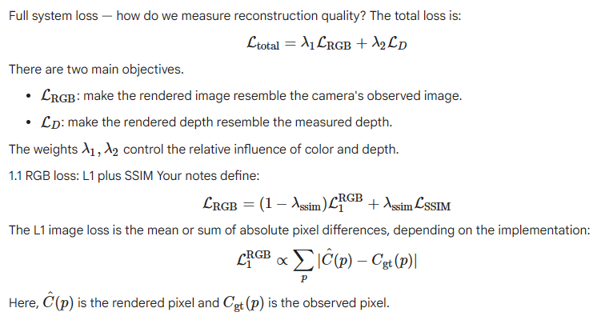

Slide 34
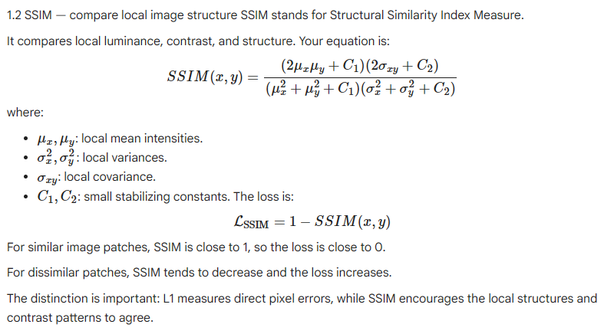

Slide 35
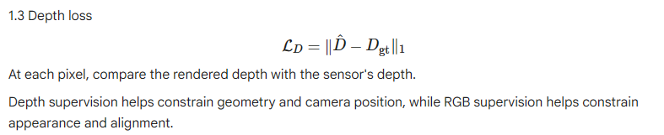

Slide 36
Adaptive Gaussian management — when should the map change?
A Gaussian map needs more than optimization of existing parameters. It must also decide when the current collection of Gaussians is insufficient.
Three operations:
Add: introduce Gaussians where the current map fails to explain observations.
Optimize: adjust existing positions, shapes, opacity, and colors.
Delete: remove Gaussians that are unhelpful or problematic.

Slide 37


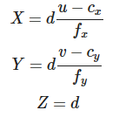
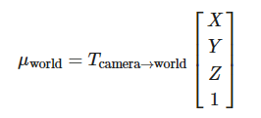
2.1 Adding a Gaussian using depth residuals The depth residual is:
If this exceeds an addition threshold, the system may decide that the map needs additional geometry around this observation. The new Gaussian center can be initialized by back-projecting the pixel:

Slide 38
2.2 Deleting poor Gaussians
Low opacity: the Gaussian contributes very little to the rendered image.
Excessive size: the Gaussian may have expanded too much or become an unhelpful representation.

Slide 39
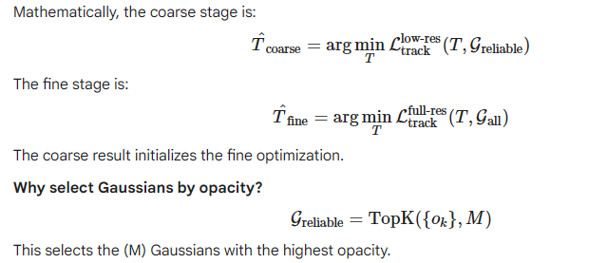
Coarse-to-fine camera tracking
Step 1 — Coarse tracking Downsample the image and use a selected subset of reliable Gaussians. Optimize an approximate camera pose cheaply.
Step 2 — Fine tracking Initialize from the coarse pose and refine it using full-resolution observations and a broader Gaussian set.

Slide 40
High opacity can be a useful heuristic because those Gaussians may have a strong influence on rendered pixels.
But opacity alone does not guarantee reliability: a high-opacity Gaussian could still be misplaced or represent a dynamic object.

Slide 41




Pose updates on the SE(3) manifold This connects directly to the pose optimization and Lie algebra concepts
The exponential map converts a six-dimensional local motion increment into a valid rigid transformation.
Consequently, the updated rotation remains a proper rotation rather than an arbitrary matrix.
World-space center (\mu_k): the parameter we want to adjust.
Projection: moving the 3D center changes its 2D image center (\mu_k').
Gaussian evaluation: changing the 2D center changes its opacity contribution at affected pixels.
Alpha blending: changing that contribution changes the final rendered color.
Image loss: the rendered color change affects the reconstruction loss.

Slide 42
The complete learning loop
Current Gaussian map + estimated camera pose
Differentiable Gaussian rendering Predict RGB and depth
Compute RGB, SSIM and depth losses
Backpropagate gradients Estimate how parameters affect the loss
Update pose and Gaussian parameters
Manage map structure Add, refine or prune Gaussians when appropriate
This is the essential idea: render → compare → differentiate → update. The map and camera pose are refined so that the predicted observations increasingly agree with the actual camera frames.

Slide 43
Tracking and Bundle Adjustment, from the basics
There are two unknowns:
Camera pose : where the camera is and which direction it faces.
Scene map : the 3D Gaussians describing the room.
GS-SLAM separates the work into three related tasks:
Tracking Estimate the camera pose for the current frame, using the existing map.
Mapping Improve the Gaussians using observed color and depth.
Bundle adjustment (BA) Refine camera poses and the map together using multiple keyframes.

Slide 44
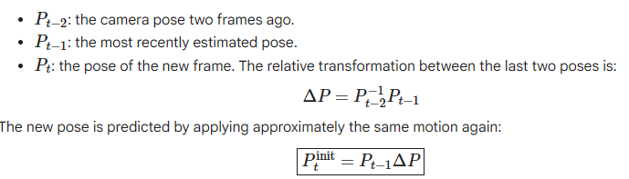
Constant-velocity initialization —
Before optimizing a camera pose, the algorithm needs a starting guess. The paper assumes that the camera continues moving approximately as it did in the previous frame.

Slide 45
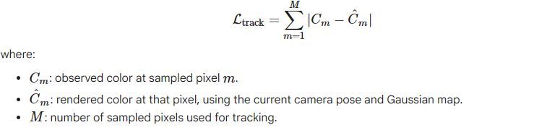
Tracking loss — how does the camera correct its guess? The paper defines the tracking loss as:

Slide 46

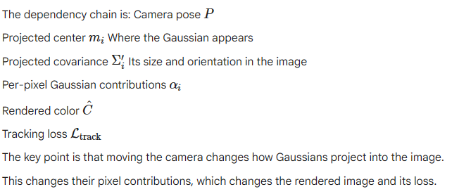
Differentiable pose estimation
The paper's rendering process has three important intermediate quantities:

Slide 47
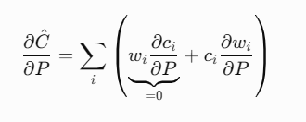
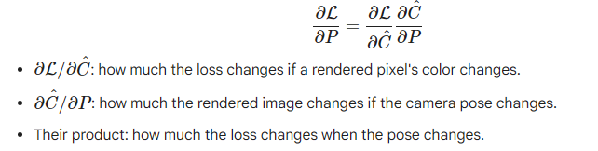


Under that assumption, the color does not change when the viewing direction changes
The camera pose also changes the projected covariance:
Differentiating this expression with respect to the camera pose is possible, but it is more computationally involved.
The authors choose to ignore the backpropagation path through this projected covariance for efficiency.

Slide 48
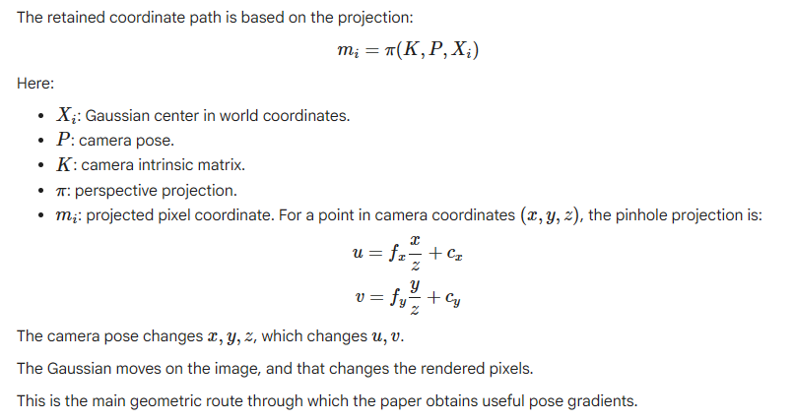

Slide 49
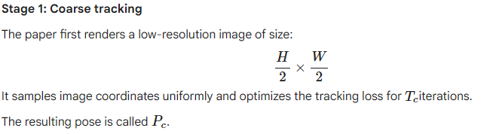
Coarse-to-fine tracking — why not optimize every pixel immediately?
The paper identifies a practical problem: rendering and optimizing with all pixels can make tracking vulnerable to artifacts.
Imagine the current Gaussian map contains a floating Gaussian that creates a false patch in the rendered image.
If the camera optimizer tries to match every pixel, this artifact can pull the estimated pose in the wrong direction.
GS-SLAM uses two stages to reduce that risk.

Slide 50
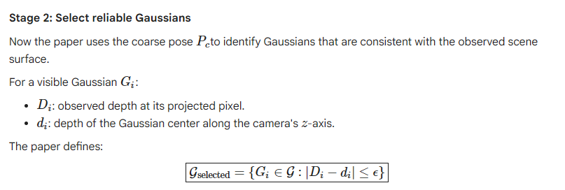
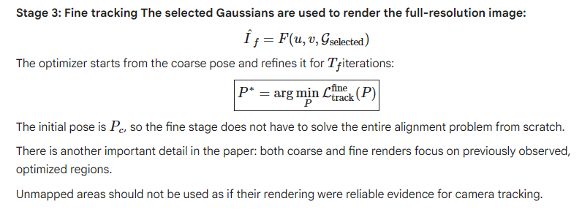

Slide 51
The full tracking sequence
New RGB frame
Predict pose using constant velocity
Coarse tracking at half resolution Obtain pose
Filter Gaussians using depth consistency
Fine tracking at full resolution Obtain refined pose
The coarse stage provides a good starting point; depth-based selection reduces the influence of unreliable geometry; and the fine stage refines the final pose.

Slide 52
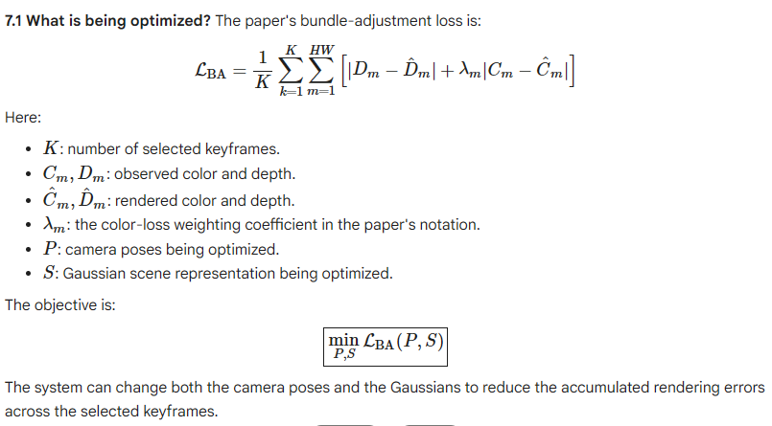
Bundle adjustment (BA)
Bundle adjustment searches for camera poses and a Gaussian map that explain these views together, rather than treating each view as an isolated reconstruction.

Slide 53
The paper uses two phases during BA.
First half of iterations: optimize the scene representation , keeping the camera poses fixed. This allows the map to adapt to the selected observations without simultaneously moving the cameras.
Second half of iterations: optimize both and the camera poses . Now the system can refine the geometry and camera alignment together.
This staged approach helps stabilize optimization. If both the map and poses change freely from the beginning, one can compensate for errors in the other, making optimization less stable.

Slide 54
Finding 1: GS-SLAM is not the fastest complete system in this table.
Finding 2: GS-SLAM uses no neural decoder.
Finding 3: GS-SLAM consumes considerably more scene memory.
More expressive color representation: potentially better view-dependent appearance, higher memory use.
Simpler color representation: lower memory use, less ability to represent directional color changes.
The authors also provide a lighter GS-SLAM configuration that uses zero-order spherical harmonics.
Zero-order SH represents color without the higher-order directional variation provided by first-degree SH.
This reduces the amount of color information stored per Gaussian.

Slide 55
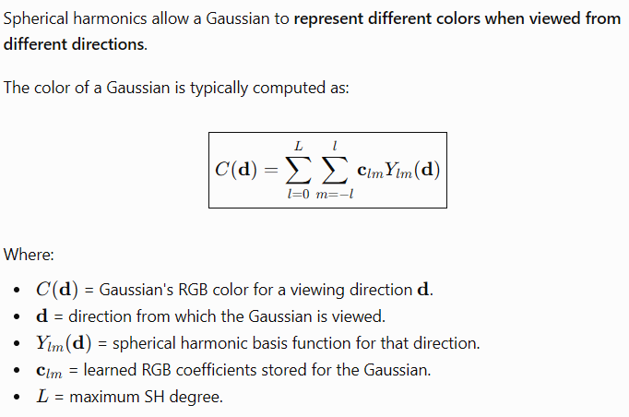

Slide 56
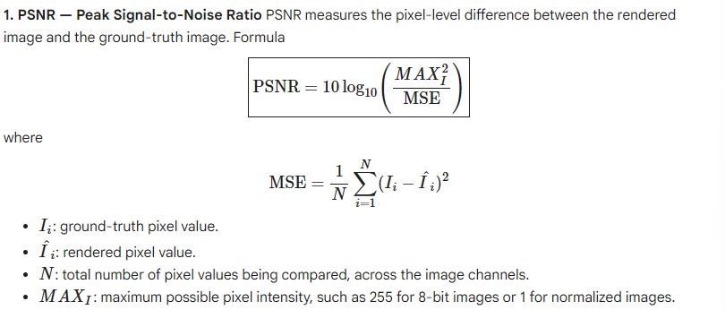

Slide 57
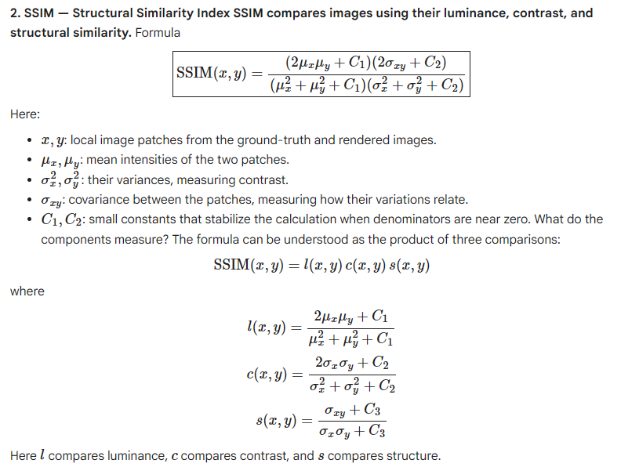

Slide 58
